Slide 1

Challenge 2 - Esports Tournament
By – Zahid Shaikh

Slide 2

Intro
The top eSports competitors from across the globe have gathered to battle it out Can you analyse the following data to find out all about the tournament?

Slide 3

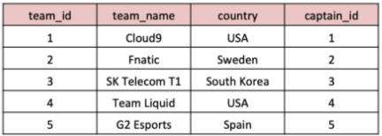
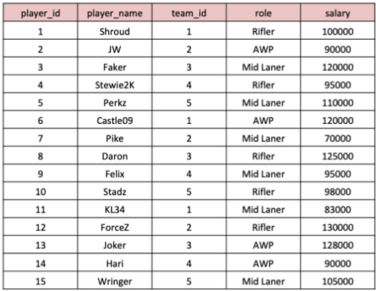
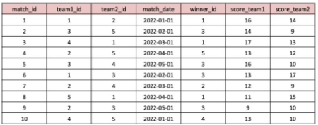
Tables
Teams
Players
Matches

Slide 4

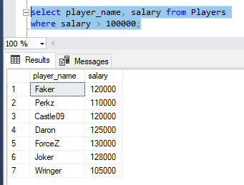
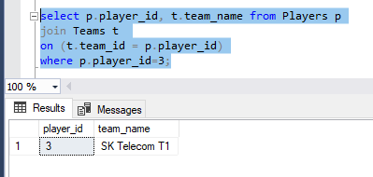
1. What are the names of the players whose salary is greater than 100,000?
2. What is the team name of the player with player_id = 3?

Slide 5

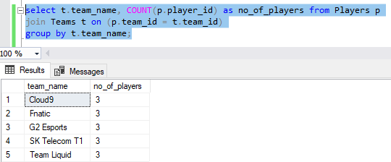
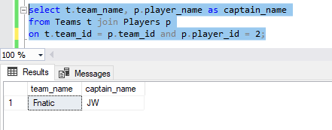
3. What is the total number of players in each team?
4. What is the team name and captain name of the team with team_id = 2?

Slide 6

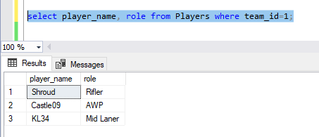
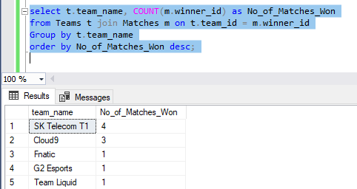
5. What are the player names and their roles in the team with team_id = 1?
6. What are the team names and the number of matches they have won?

Slide 7

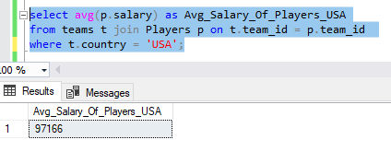
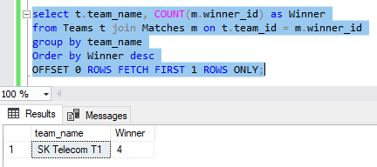
7. What is the average salary of players in the teams with country 'USA'?
8. Which team won the most matches?

Slide 8

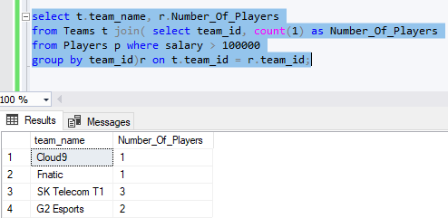
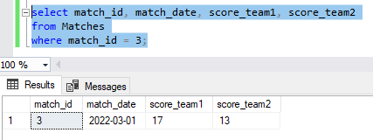
9. What are the team names and the number of players in each team whose salary is greater than 100,000?
10. What is the date and the score of the match with match_id = 3?

